Slide 1


ResNet50-1D-CNN: A new lightweight resNet50-One-dimensional
convolution neural network transfer learning-based approach for improved intrusion detection in cyber-physical systems
Author:Yakub Kayode Saheed, Oluwadamilare Harazeem AbdulganiyuKaloma, Usman Majikumna,Musa Mustapha, Abedaw Degu Workneh.(April 2024)
MD MAHFUZUR RAHMAN
Student ID: 3123999081
2024.5.23

Slide 2
C
ONTENTS
1
Introduction
2
Problem Statement
3
Proposed Solution
4
System Architecture
5
Methodology
6
Results
7
Discussion
8
Conclusion

Slide 3
01
Intruduction

Slide 4

Introduction
Background
Cyber-physical systems (CPS) are essential for infrastructure like water treatment, gas stations, and power grids.
CPS are increasingly vulnerable to cyber-attacks that can disrupt physical processes.
Importance of Intrusion Detection Systems (IDS)
Cyber- Traditional security measures (e.g., firewalls, encryption) are insufficient for CPS.
Machine learning-based IDS can enhance CPS security by identifying malicious activities.

Slide 5
02
Problem Statement

Slide 6
Problem Statement
Increasing Vulnerability of CPS to Cyber-Attacks
Limitations of Traditional Security Measures
Need for an Advanced Intrusion Detection System (IDS)
CPS are becoming more interconnected and complex, which increases their exposure to cyber threats.
Successful cyber-attacks on CPS can lead to significant disruptions and potential physical damage.
Existing security measures such as firewalls, encryption, and signature-based detection systems are not sufficient to protect CPS.
These measures often fail to detect sophisticated and evolving cyber threats.
There is a need for a robust IDS that can adapt to new and unknown threats.
The IDS should leverage advanced techniques such as machine learning and deep learning to improve detection accuracy and response time.

Slide 7
03
Propose Solution

Slide 8
Proposed Solution
Introduction to ResNet50–1D-CNN Model
The proposed model integrates the ResNet50 architecture with 1D Convolutional Neural Networks (1D-CNN).
ResNet50, originally designed for image classification, is adapted for one-dimensional data to address the specific needs of intrusion detection in CPS.
Utilizes transfer learning to leverage pre-trained knowledge and improve feature extraction.
Benefit of Transfer Learning
Lightweight and Efficient
.
Enhanced Detection Performance
Scalability

Slide 9
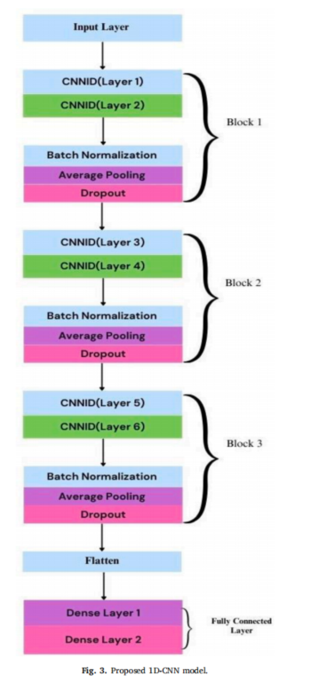
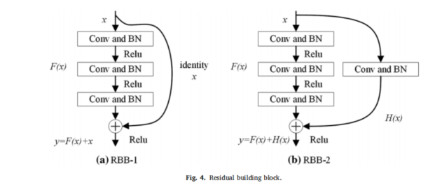
Propose Solution

Slide 10
04
System Architecture

Slide 11
System Achitecture
Detailed Architecture of the Proposed IDS:
Data Collection and Input
CPS data is collected from various sensors and devices.
Data types include network traffic, system logs, and sensor readings.
Preprocessing
Data is cleaned and normalized.
Feature selection is performed to identify the most relevant attributes for intrusion detection.
Model Architecture
The architecture consists of multiple layers, including convolutional layers, residual blocks, and fully connected layers.
The ResNet50 backbone extracts high-level features, while the 1D-CNN processes these features to detect anomalies.
Detection and Output
The model classifies the input data as normal or malicious.
Alerts are generated for detected anomalies, enabling timely responses to cyber threats.

Slide 12
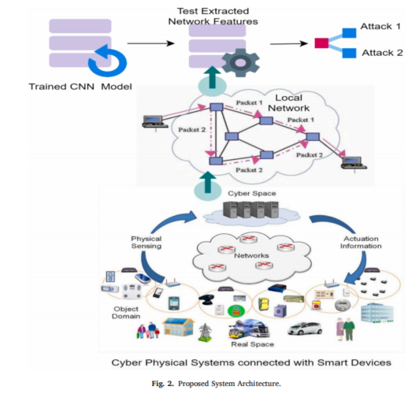
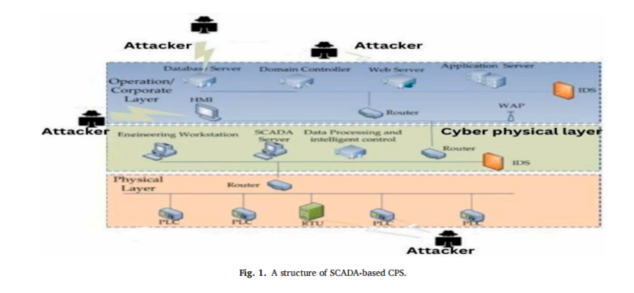
System Architecture

Slide 13
05
Methodology

Slide 14



Methodology
Data Preparation
Datasets Used:
HAI dataset and UNSW-NB15 dataset.
Both datasets are well-known for evaluating intrusion detection systems.
Preprocessing Steps:
Data cleaning, normalization, and feature selection.
Handling missing values and noise reduction.
Model Training
Training Process:
The ResNet50–1D-CNN model is trained on the prepared datasets.
Uses transfer learning to leverage pre-trained models.
Hyperparameters:
Specific hyperparameters are tuned for optimal performance.
Key hyperparameters include learning rate, batch size, and number of epochs.
Evaluation Metrics:
Performance Metrics:
Accuracy, precision, recall, and F1-score.
These metrics are used to evaluate the effectiveness of the model.

Slide 15
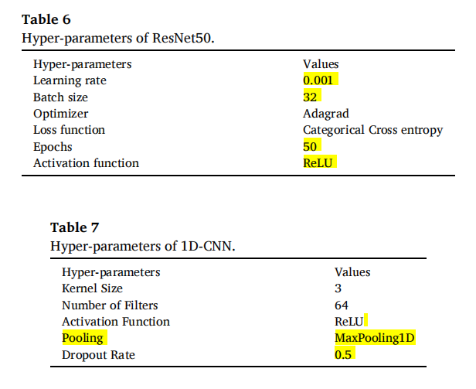
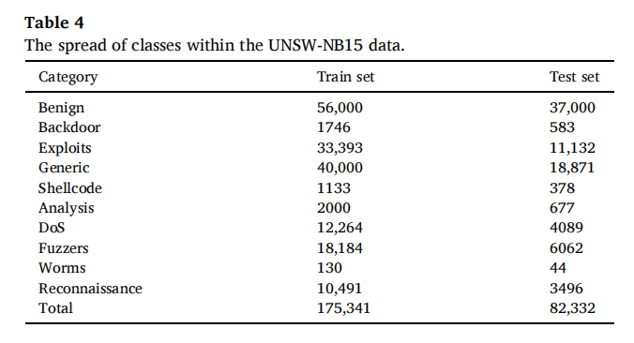
Methodology

Slide 16
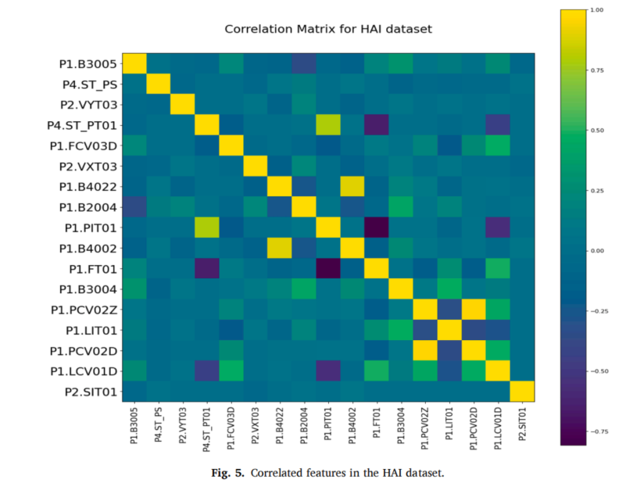
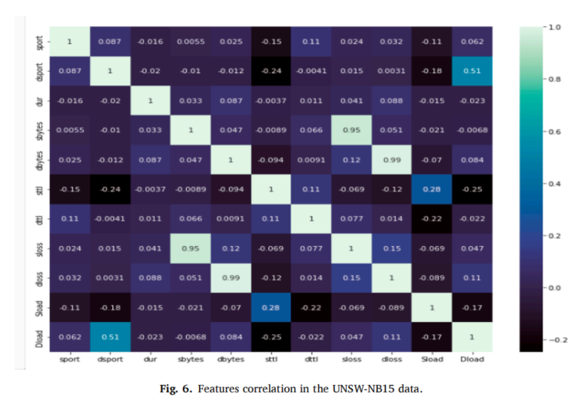
Methodology

Slide 17
06
Result

Slide 18
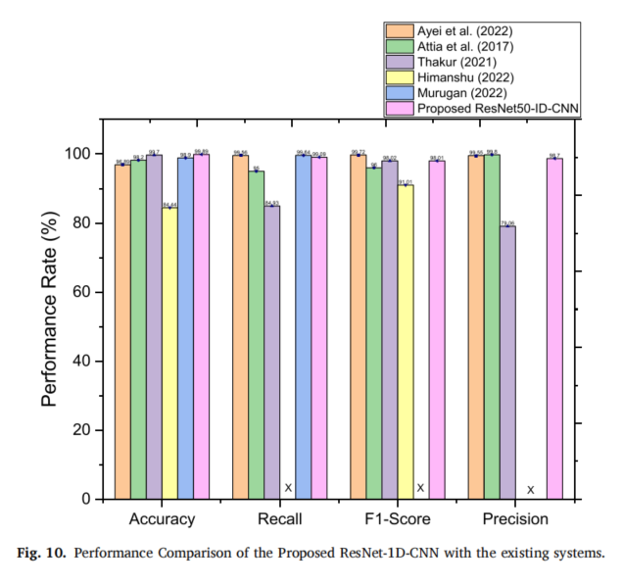
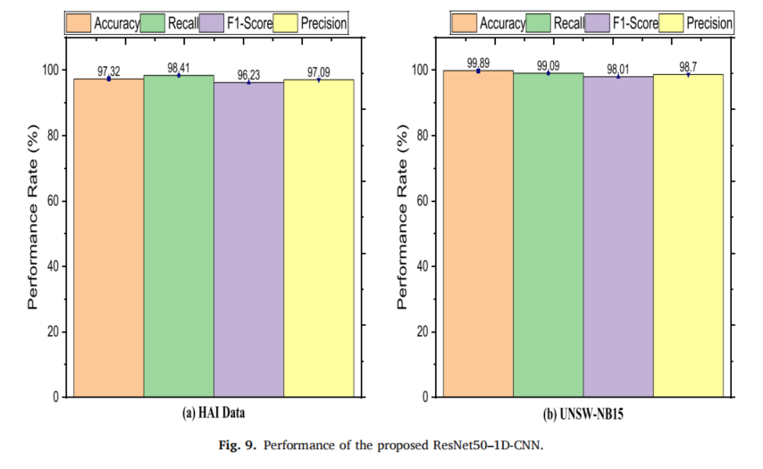
Result

Slide 19
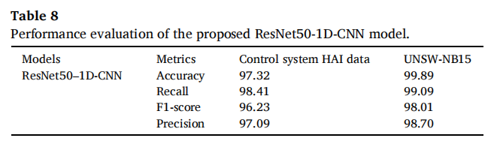
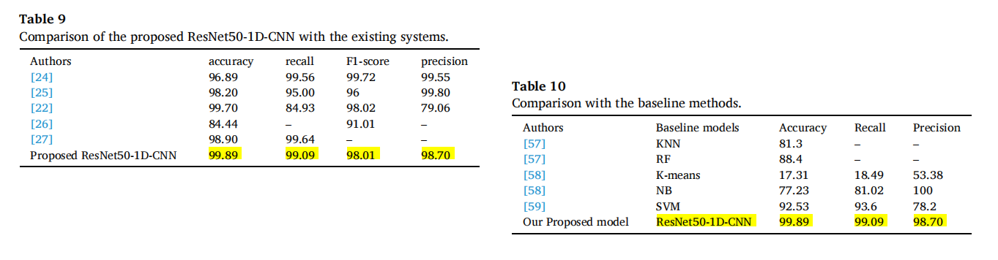
Result

Slide 20
07
Discussion

Slide 21
Discussion
Analysis of Results
Strengths of the Proposed Model:
High accuracy and robustness in detecting various types of intrusions.
Efficiency in processing large volumes of data in real-time.
Limitations and Challenges:
Potential challenges in adapting the model to new types of attacks.
Need for continuous updates and retraining to maintain effectiveness.

Slide 22
08
Conclusion

Slide 23
Conclusion
Summary of Findings
Effectiveness of ResNet50–1D-CNN
Demonstrated high performance in intrusion detection.
Outperformed existing systems in most evaluation metrics.
Implications for CPS Security
Enhanced Protection
Provides a robust and efficient solution for real-time intrusion detection.
Can significantly improve the security of critical infrastructure.
This paper introduces a transfer learning model for detecting anomalies in CPS networks. Our approach involves utilizing authentic control systems HAI and UNSW-NB15 information to detect anomalous behavior in CPS networks. We employ ResNet50-1D-CNN models to classify different anomalies. The model undergoes training using a substantial dataset, incorporating transfer learning techniques to enhance the dataset’s performance and minimize the training complexity of the model.
The results demonstrate an accuracy of 97.32 % and 99.89 % when using the Control System HAI and UNSWNB- 15 datasets, respectively.

Slide 24
Thanks

